Slide 1



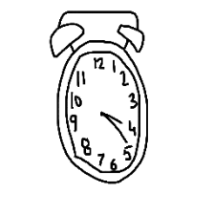
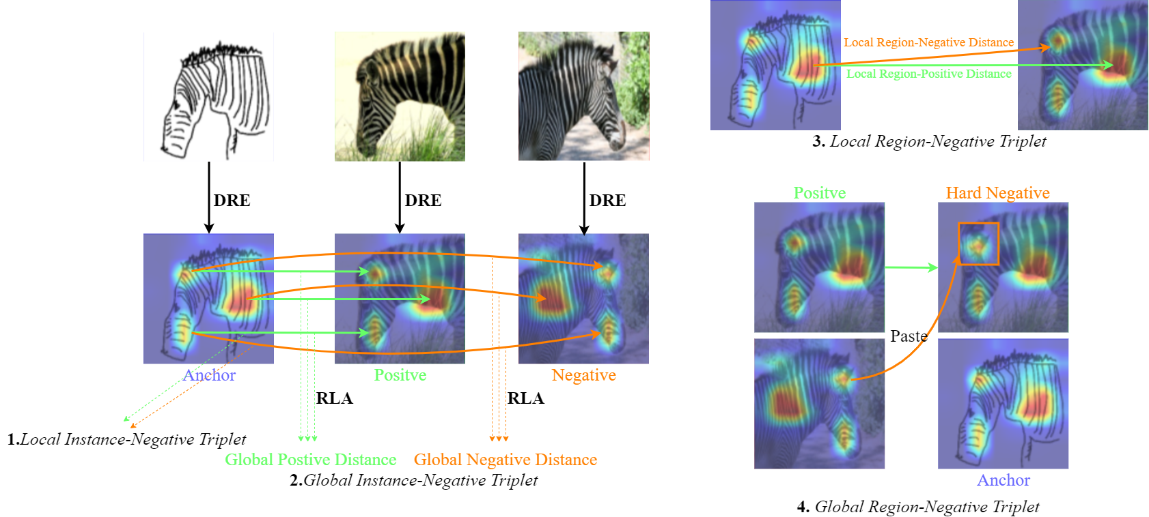
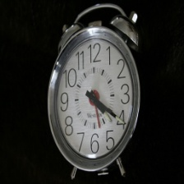

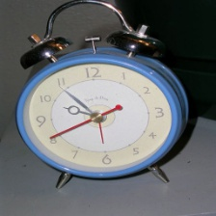
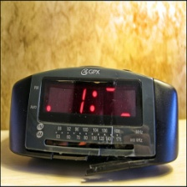

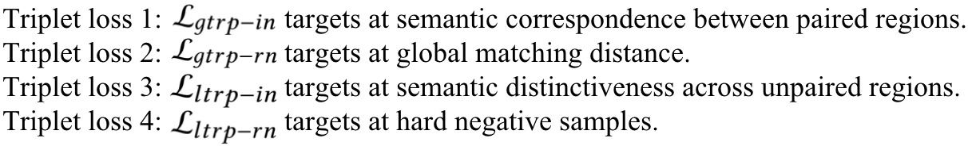
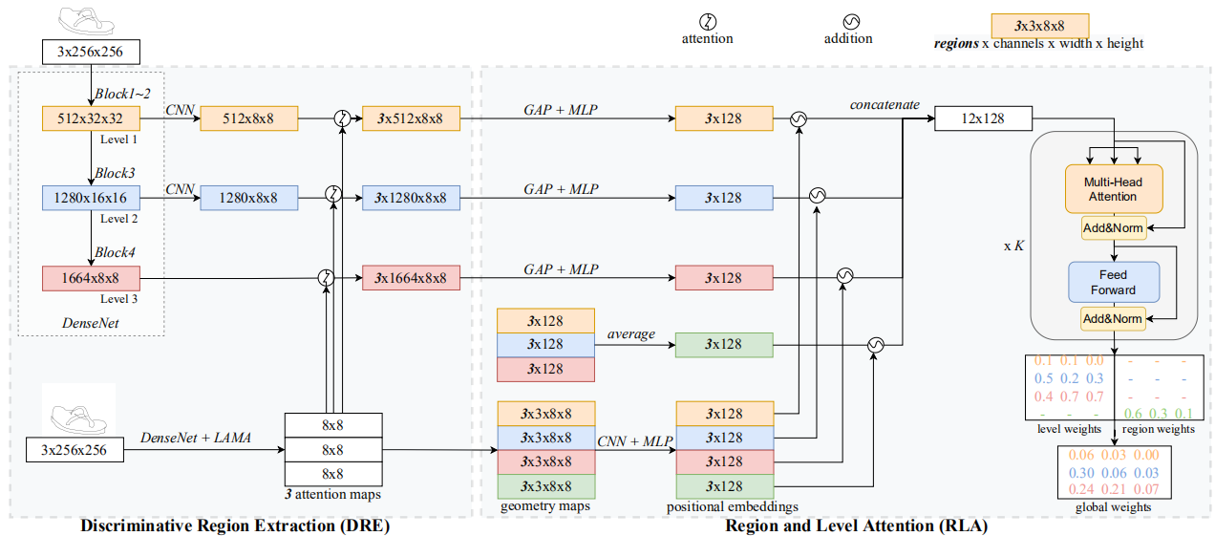
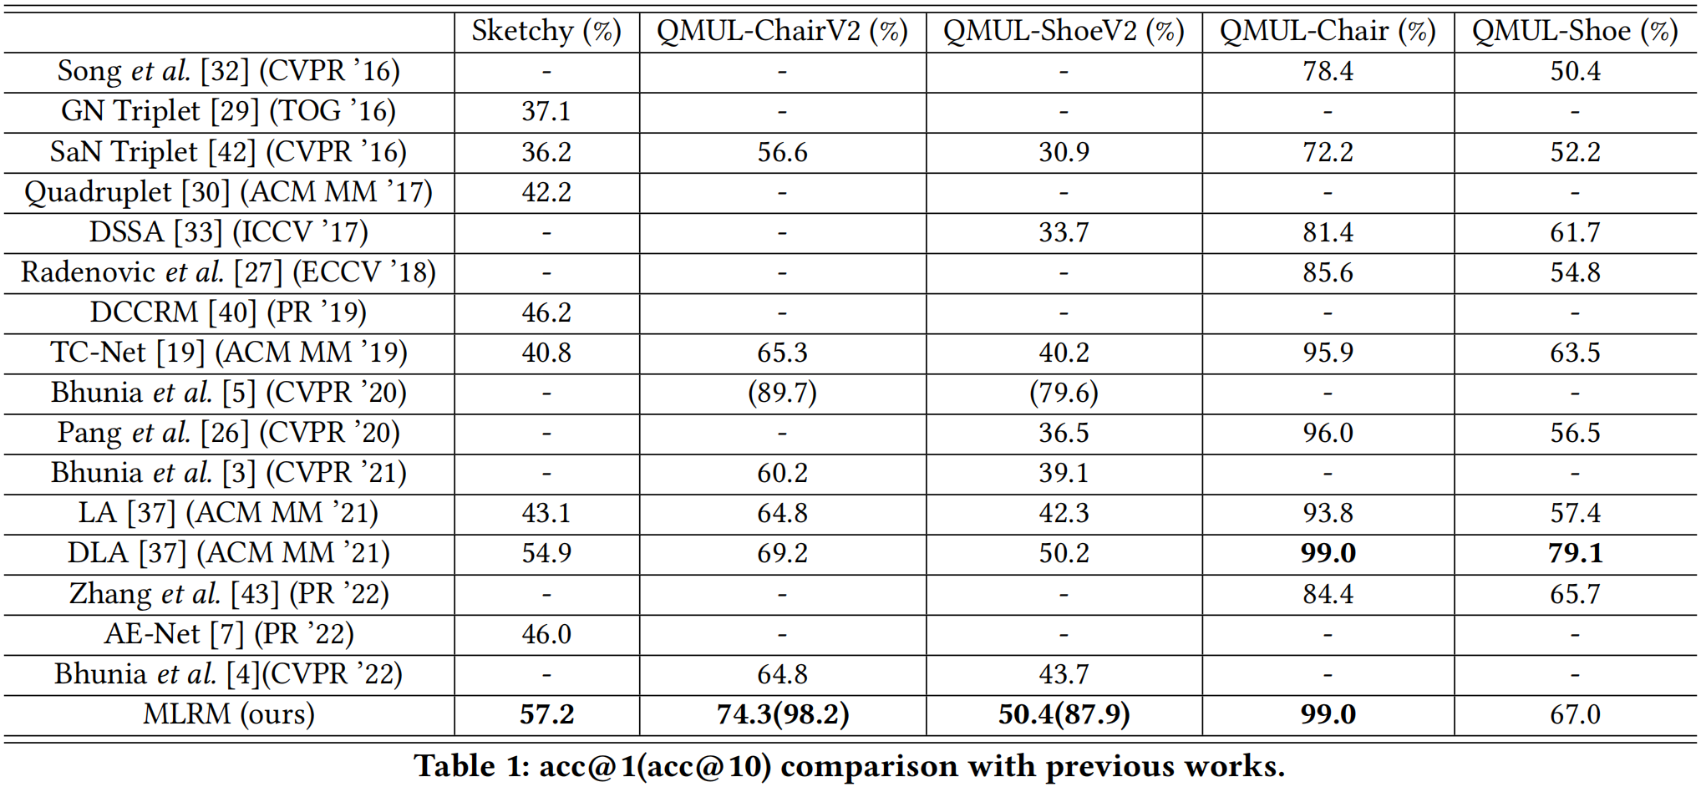
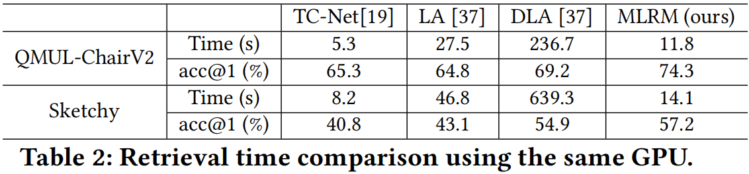
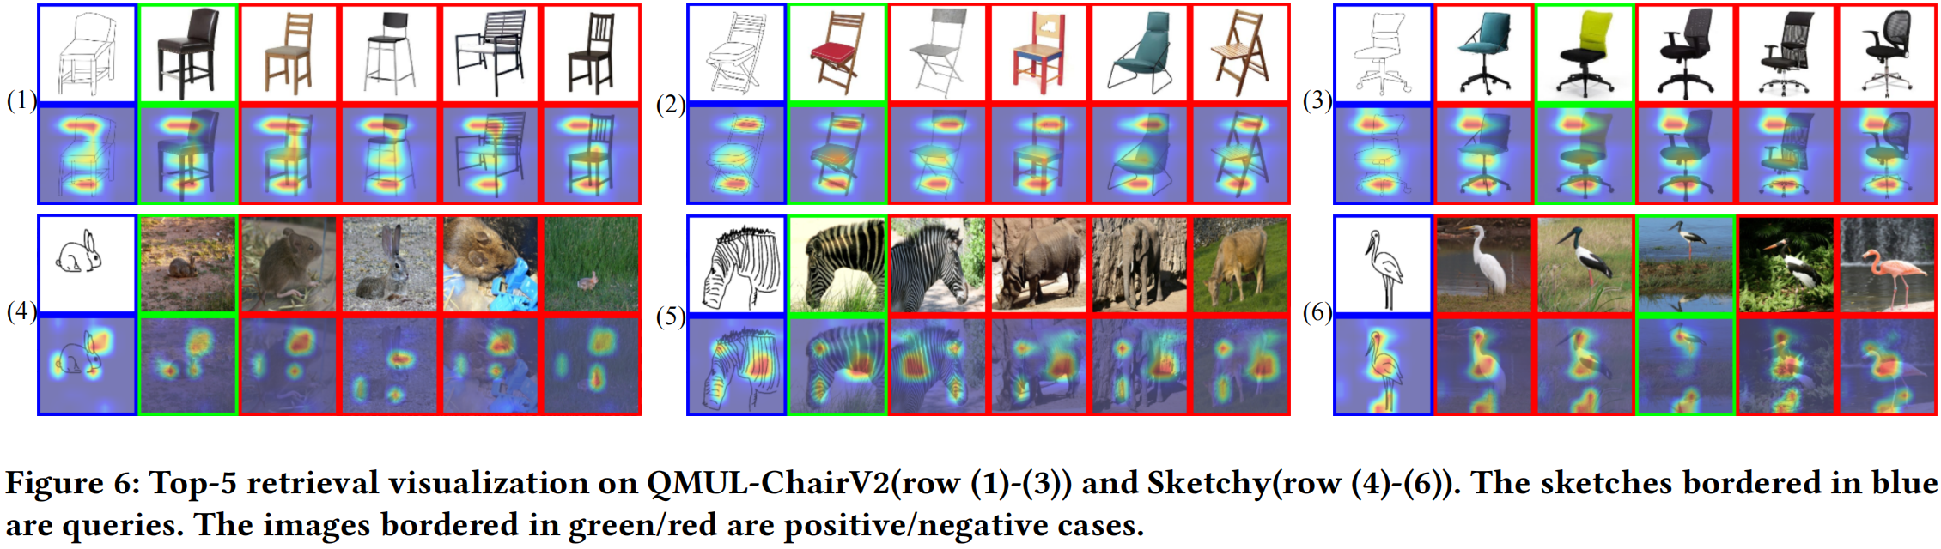
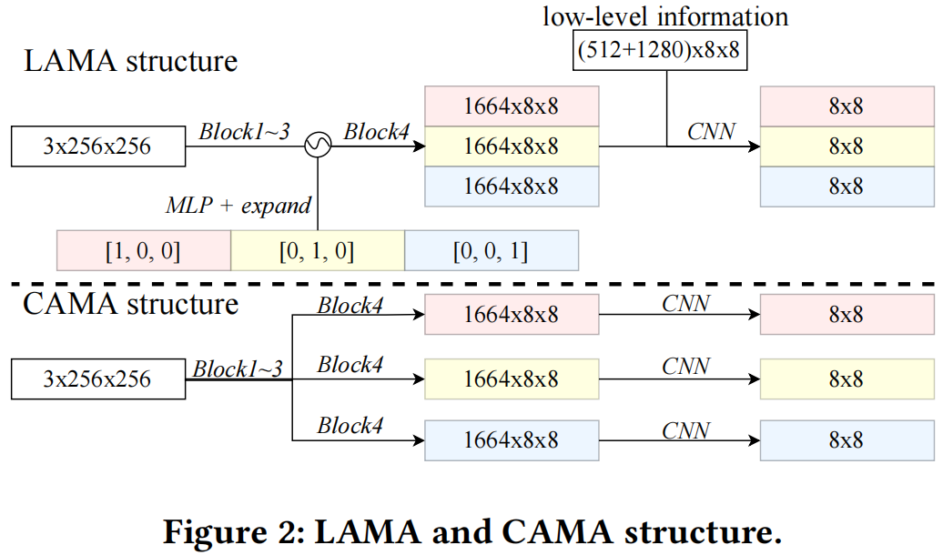
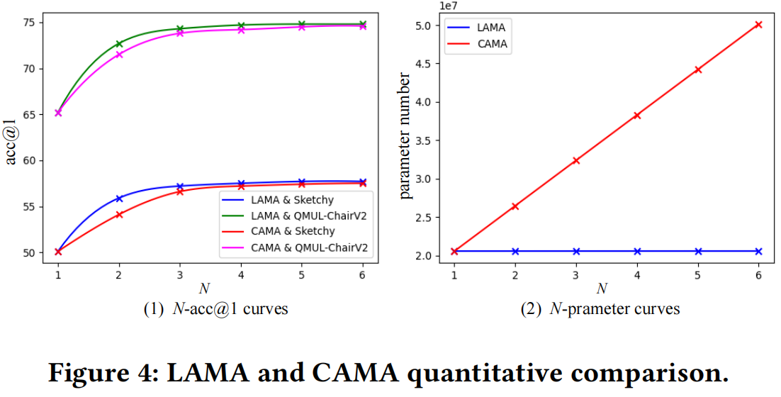
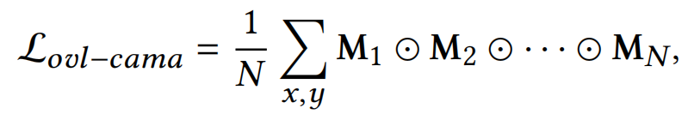
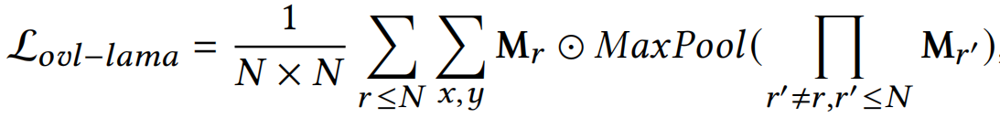
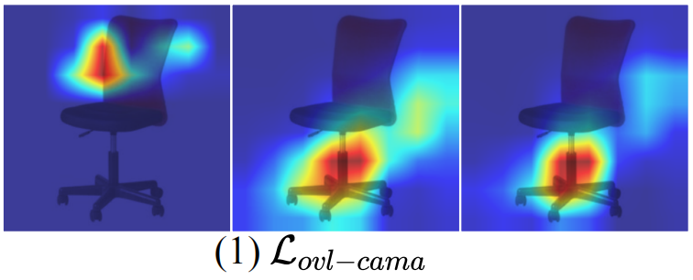
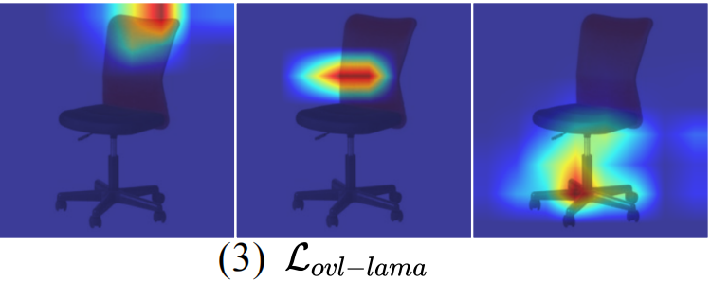
Paper ID #1665
Multi-Level Region Matching for Fine-Grained Sketch-Based Image Retrieval
Zhixin Ling
1069066484@qq.com
Fudan University
Zhen Xing
zxing20@fudan.edu.cn
Fudan University
Jiangtong Li
keep_moving-Lee@sjtu.edu.cn
Shanghai Jiao Tong University
Li Niu*
ustcnewly@sjtu.edu.cn
Shanghai Jiao Tong University
Task Setting
Triplet Losses
The Query Sketch
Positive Cases
Negative Cases
Positive Case
Negative Cases
Coarse-Grained Sketch-Based Image Retrieval (CG-SBIR)
Fine-Grained Sketch-Based Image Retrieval (FG-SBIR)
Framework
Experiments
Overview of the proposed MLRM
In DRE, we propose a LAMA structure to extract different attention maps to attend multi-level CNN feature maps.
In RLA, we adopt a transformer-based attentive matching module to obtain attention weights for different regions and levels.
At last, we aggregate region/level-wise distances by weights as a retrieval distance.
LAMA v.s. CAMA
Our MLRM achieved SOTA on all datasets except QMUL-Shoe, on which MLRM is the second best.
Our MLRM does not introduce much extra computation overhead.
Our MLRM can well extract both geometrically and semantically discriminative regions.
Conclusion
To establish fine-grained correspondence between sketches and im_x0002_ages, we propose Multi-Level Region Matching (MLRM).
MLRM consists of DRE that generates discriminative regions and RLA to obtain attention weights for different regions and levels.
Comprehensive experiments have demonstrated that MLRM achieves SOTA acc@1 at the cost of a relatively low computation overhead.
Inspired by CAMA, we propose LAMA to extract discriminative regions.
LAMA merges different network branch copies into one, saving a large number of parameters when improving model performance.
LAMA adopts an improved overlapping penalty, learning better geometrically discriminative regions.
Acknowledgements
The work is supported by Shanghai Municipal Science and Technology Major Project, China (2021SHZDZX0102), and Shanghai Municipal Science and Technology Key Project (Grant No. 20511100300), and National Science Foundation of China (61902247).

